Slide 1
BDD and the Sleepy Developer
Dermot Canniffe

Slide 2

Notes:
Hello, everyone. I’m Dermot, and I’m a sleepy head. Clinically speaking.

Slide 3
Notes:
Hello, everyone. I’m Dermot, and I’m a sleepy head. Clinically speaking.

Slide 4
…conditions that affect sleep quality, timing, or duration and impact a person’s ability to properly function while they are awake. - Sleep Foundation
Notes:
What are Sleep Disorders?

Slide 5
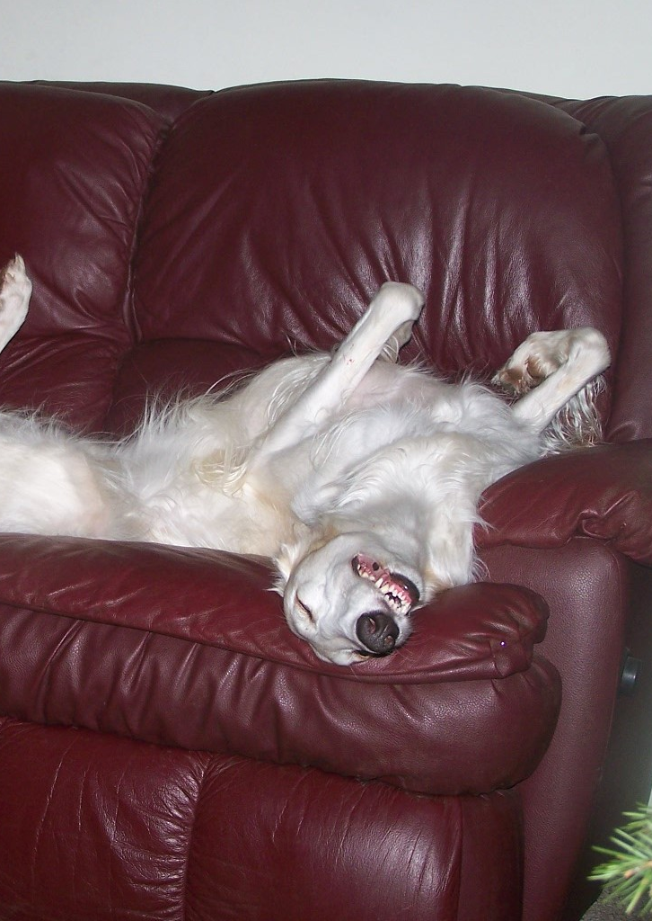


Insomnia
Sleep Apnoea
Narcolepsy
Shift Work Disorder
Idiopathic Hypersomnia
Parasomnias
…
Notes:
Some Sleep Disorders
https://www.flickr.com/photos/ferlinka/2137930667/ Deb West (CC BY 2.0)

Slide 6
“Oh, I get that!”
- most people I talk to about sleep disorders
Notes:
Parasomnias != Sleep Disorder Idiopathic Hypersomnia - Idiopathic hypersomnia was first described in 1976 – and the name still holds! We still don’t know what exactly causes it. People’s experience is subjective and reporting is poor. We don’t even know that much about sleep: why do we sleep? Necessary biological “rinse cycle” or weird evolutionary quirk?

Slide 7
Sleep problems and work injuries: A systematic review and meta-analysis – K. Uehli et al
The findings of the meta-analysis suggested that workers with sleep problems had a 1.62 times higher risk of being injured than workers without sleep problems (RR: 1.62, 95% CI: 1.43–1.84). Approximately 13% of work injuries could be attributed to sleep problems.
Insomnia and its relationship to health-care utilization, work absenteeism, productivity and accidents – M. Daley et al
In terms of daytime function, 25.0% of the [Insomnia Syndrome Group] had been absent from work relative to 17.1% of [the Good Sleeper Group], 40.6% reported having experienced reduced productivity compared to 12.3% of [Good Sleepers]
Notes:
Sleep Disorders and Working life
Katrin Uehli, Amar J. Mehta, David Miedinger, Kerstin Hug, Christian Schindler, Edith Holsboer-Trachsler, Jörg D. Leuppi, Nino Künzli,
Sleep problems and work injuries: A systematic review and meta-analysis,
Sleep Medicine Reviews,
Volume 18, Issue 1,
2014,
Pages 61-73,
ISSN 1087-0792,
https://doi.org/10.1016/j.smrv.2013.01.004.
(https://www.sciencedirect.com/science/article/pii/S1087079213000087) Daley M, Morin CM, LeBlanc M, Grégoire JP, Savard J, Baillargeon L. Insomnia and its relationship to health-care utilization, work absenteeism, productivity and accidents. Sleep Med. 2009 Apr;10(4):427-38. doi: 10.1016/j.sleep.2008.04.005. Epub 2008 Aug 26. PMID: 18753000.

Slide 8
Sleep problems and work injuries: A systematic review and meta-analysis – K. Uehli et al
The findings of the meta-analysis suggested that workers with sleep problems had a 1.62 times higher risk of being injured than workers without sleep problems (RR: 1.62, 95% CI: 1.43–1.84). Approximately 13% of work injuries could be attributed to sleep problems.
Insomnia and its relationship to health-care utilization, work absenteeism, productivity and accidents – M. Daley et al
In terms of daytime function, 25.0% of the [Insomnia Syndrome Group] had been absent from work relative to 17.1% of [the Good Sleeper Group], 40.6% reported having experienced reduced productivity compared to 12.3% of [Good Sleepers]
Notes:
Sleep Disorders and Working life
Katrin Uehli, Amar J. Mehta, David Miedinger, Kerstin Hug, Christian Schindler, Edith Holsboer-Trachsler, Jörg D. Leuppi, Nino Künzli,
Sleep problems and work injuries: A systematic review and meta-analysis,
Sleep Medicine Reviews,
Volume 18, Issue 1,
2014,
Pages 61-73,
ISSN 1087-0792,
https://doi.org/10.1016/j.smrv.2013.01.004.
(https://www.sciencedirect.com/science/article/pii/S1087079213000087) Daley M, Morin CM, LeBlanc M, Grégoire JP, Savard J, Baillargeon L. Insomnia and its relationship to health-care utilization, work absenteeism, productivity and accidents. Sleep Med. 2009 Apr;10(4):427-38. doi: 10.1016/j.sleep.2008.04.005. Epub 2008 Aug 26. PMID: 18753000.

Slide 9

Stalin is too crude, and this defect which is entirely acceptable in our milieu and in relationships among us as communists, becomes unacceptable in the position of General Secretary. I therefore propose to comrades that they should devise a means of removing him from this job and should appoint to this job someone else who is distinguished from comrade Stalin in all other respects only by the single superior aspect that he should be more tolerant, more polite and more attentive towards comrades, less capricious, etc.
—Lenin, 4 January 1923

Slide 10


“Brian Fog”
“Brairn Frog”
“Brain Forg”
“Brain Fog”
Hallucinations
Notes:
Sleep Disorders and Working life
Aside from the actual sleep disturbances and sleepiness happening during inconvenient times
Some of the main ones are ; Sleep Drunkenness Decreased Energy Restlessness Irritability “Brain Fog” Inability to focus Memory problems Hallucinations
Marco Verch - the CC-BY license https://creativecommons.org/licenses/by/2.0/

Slide 11
Notes:
Behaviour Driven Development Practices

Slide 12
Notes:
Behaviour Driven Development Culture

Slide 13
Notes:
Conclusions

